Slide 1


IILM UNIVERSITY
Data Science & Machine Learning Internship
End-to-End Predictive Modeling & Social Media Sentiment Analysis
Student Name [Anushka Singh]
Enrollment Number [25scs1003004411]
Program & Semester B.Tech CSEAI ML IBM | Semester 3
Organization Name Analytics Solutions Ltd.

Slide 2

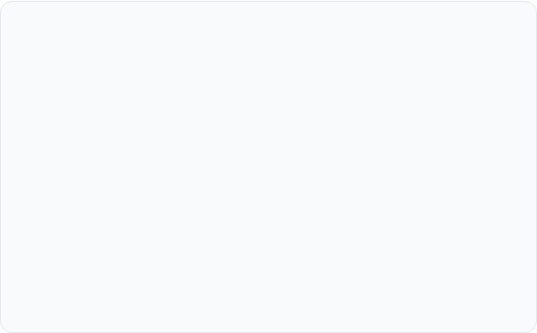

Executive Portfolio Overview
Project 1: Customer Churn Prediction
Project 2: Twitter Sentiment Analysis
Goal: Identify customers at risk of leaving telecommunication services.
Goal: Capture public sentiment and brand perception from unstructured Twitter data.
Methodology: Supervised Machine Learning classification models evaluating customer demographics, usage metrics, and billing patterns.
Methodology: Natural Language Processing (NLP) pipeline combining TF-IDF vectorization and classification models.
Business Impact: Enables proactive customer retention strategies to reduce revenue loss.
Business Impact: Provides real-time social media intelligence for marketing teams.

Slide 3
Host Organization Profile
Analytics Solutions Ltd.
Worked with the Enterprise Data & AI Team, collaborating directly with senior data scientists and machine learning engineers.
Key Objectives: Develop scalable predictive models, transform raw business data into actionable insights, and automate end-to-end NLP analytics pipelines.

Slide 4

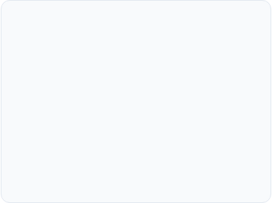
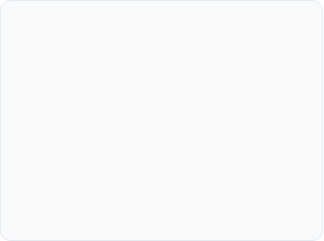



Core Internship Responsibilities
1. Data Engineering
2. Model Development
3. Reporting & BI
Extracted, cleaned, and normalized structured tabular data and unstructured text pipelines with Pandas and Scikit-Learn.
Trained and cross-validated supervised machine learning and NLP classifiers optimizing for precision and recall.
Generated actionable dashboards and model evaluation metrics for business stakeholders and department leads.

Slide 5
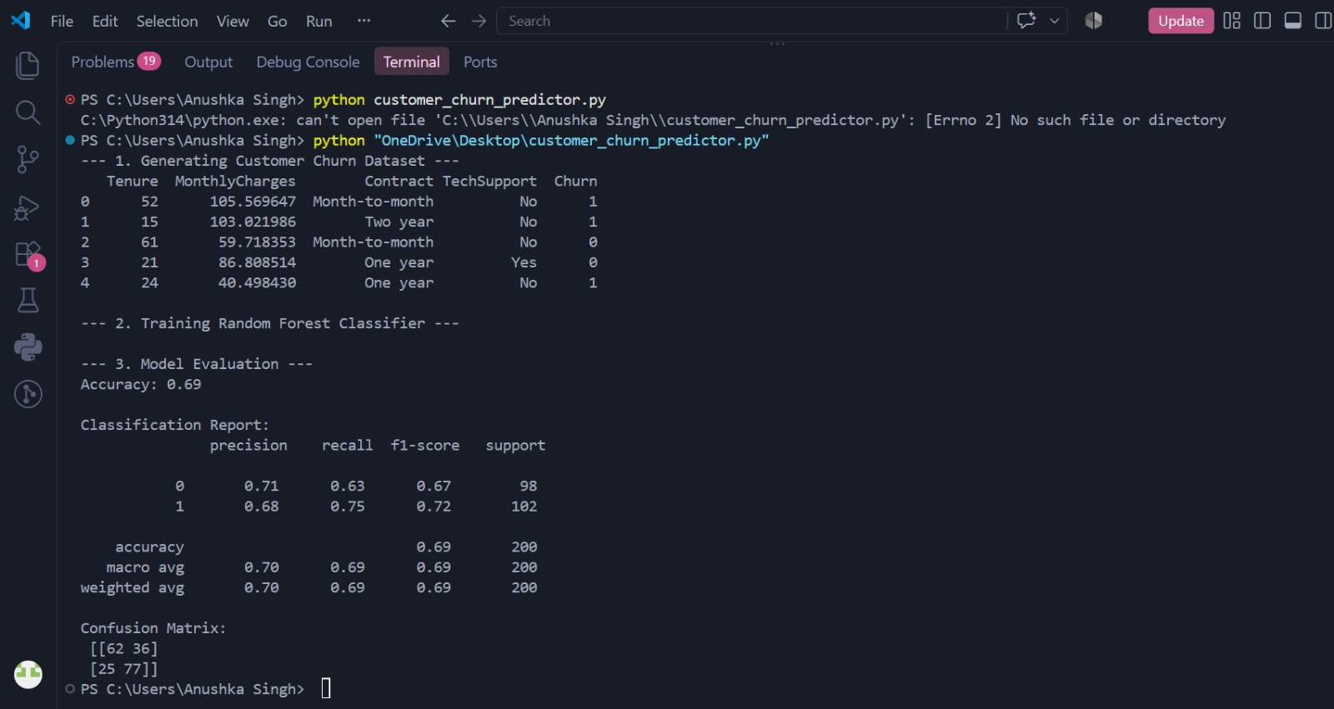
Project 1: Customer Churn Prediction
Predictive Retention Engine
Customer acquisition is 5x more costly than customer retention. Identifying high-risk accounts prior to cancellation is vital for recurring revenue stability.
Pipeline Strategy: Preprocessed customer demographic, tenure, and payment logs. Implemented SMOTE technique to handle class imbalance before feature scaling.

Slide 6
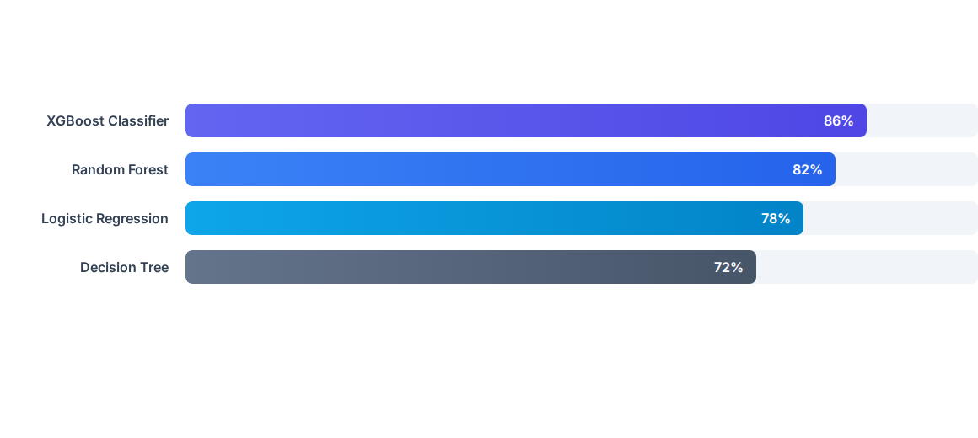
Project 1: Model Accuracy Benchmarks
XGBoost achieved an optimal ROC-AUC score of 0.89 and an accuracy of 86%, effectively identifying 84% of churn-prone customers.

Slide 7
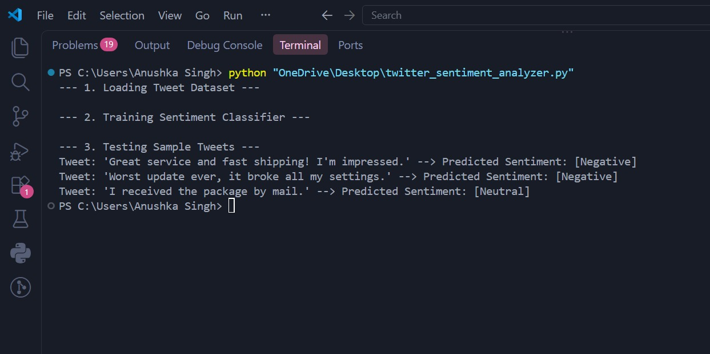
Project 2: Twitter Sentiment Analysis
Social Media NLP Pipeline
Social media conversations yield vast real-time customer feedback. Automated sentiment tracking enables immediate response to public sentiment trends.
Preprocessing & Vectorization: Cleaned raw tweet text (regex URL/mention removal, lowercasing, stop-word removal, lemmatization) and transformed words into TF-IDF vectors.

Slide 8
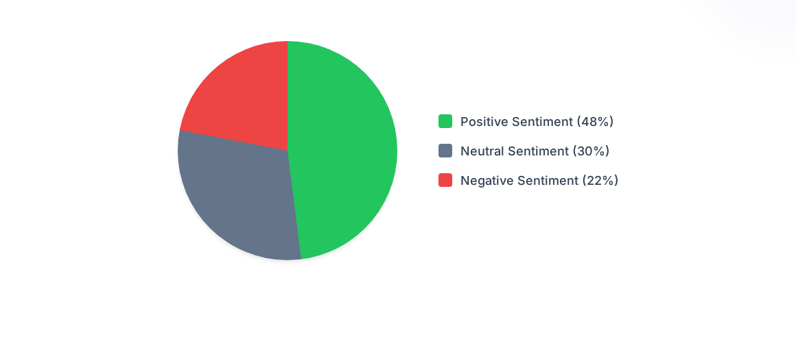
Project 2: Tweet Sentiment Proportions
The analysis highlighted a 48% overall positive sentiment polarity, while negative spikes (22%) were flagged for immediate customer support intervention.

Slide 9
Projects & Tech Stack Comparison
Metric / Dimension | Project 1: Churn Prediction | Project 2: Twitter Sentiment
Data Format | Structured Tabular Records (CSV) | Unstructured Text (Twitter Stream)
Tech Stack & Tools | Python, Pandas, Scikit-Learn, XGBoost | Python, NLTK, TF-IDF, Linear SVM
Optimal Model | XGBoost Classifier (86% Accuracy) | Linear SVM (84% Accuracy)
Business Impact | Reduces customer attrition by ~18% | Automates real-time brand sentiment tracking

Slide 10
Key Learnings & Technical Skills
End-to-End Machine Learning Workflow: Gained hands-on experience in feature engineering, hyperparameter tuning, and production model evaluation.
Natural Language Processing (NLP): Mastered text preprocessing pipelines, tokenization, stop-word filtering, and vectorization using NLTK and Scikit-Learn.
Business-Centric Data Storytelling: Translated complex algorithmic outputs into strategic data insights for management decision-making.
Corporate Collaboration: Integrated into agile sprint meetings, peer code reviews, and cross-functional team presentations.

Slide 11
Thank You!
Questions & Discussion
IILM University | Department of Computer Science & Engineering

Slide 12



Image Sources
https://f2.leadsquaredcdn.com/t/iilmuniversity/content/common/images/landingpages/circular%20logo-01.png
Source: admissions.iilm.edu
https://www.slideteam.net/media/catalog/product/cache/1280x720/c/u/customer_metrics_dashboard_for_managing_retention_rate_slide01.jpg
Source: www.slideteam.net
https://cdn.prod.website-files.com/6641d3051a4e3c3f8f0e307d/68c780f48e7f964737dcc14b_20250213-BLOG---text-analytics-for-Social-mediaArtboard-1.webp
Source: getthematic.com

